Slide 1

Over under Investment Tool
Fintech project 1
Andy Liang
Sean Brennan

Slide 2
Can we create a tool using DCF modeling to over or under value a stock?
We built a model using discounted cash flow modeling to evaluate stock prices and give the everyday investor a tool to evaluate if a stock is over or undervalued.
To do this work we evaluated 5 years of historical financial statements and the predicted future values for 5 years of forecasted financial statements to create an evaluation of the company and what we believe the stock to be valued at the current day.
We tested this concept in two ways via a single stock analysis as well we tried to look at a balance portfolio of stocks based on choosing to invest in what we felt based on the model were under valued and measured this against the S&P 500 index to see how we would perform.

Slide 3
Overview
Question to answer – can we develop a model to tell if a stock is over or under valued?
Understanding the model - We will walk through the code and concept of the DCF modeling.
Proof of concept
Test single stock case as a proof of concept
Test portfolio investment strategy of an equally weighted portfolio of undervalued stocks based on the DCF model and evaluate using 5 years of historical data as well performing MonteCarlo simulations.
Conclusions
Final Thoughts, next steps?

Slide 4

The DCF Model Explained

Slide 5

Proof of Concept

Slide 6
Companies to Test – random selection from tech stocks
Company | Ticker | Current Price | DCF Model Value | Over/Under
Amazon | AMZN | $3,385.38 | $11,538.67 | Under
Tesla | TSLA | $700.00 | $400.63 | Over
Facebook | FB | $310.60 | $319.62 | Under
Google | GOOG | $2,257.50 | $1,461.96 | Over
Square | SQ | $264.81 | $17.57 | Over
iRobot | IRBT | $113.58 | $92.81 | Over
Roku | ROKU | $370.59 | $42.86 | Over
Alibaba | BABA | $242.66 | $4,193.19 | Under
Salesforce | CRM | $229.13 | $197.58 | Over
Microsoft | MSFT | $257.29 | $171.98 | Over
Netflix | NFLX | $553.23 | $3,769.67 | Under
Apple | APPL | $131.24 | $84.63 | Over

Slide 7
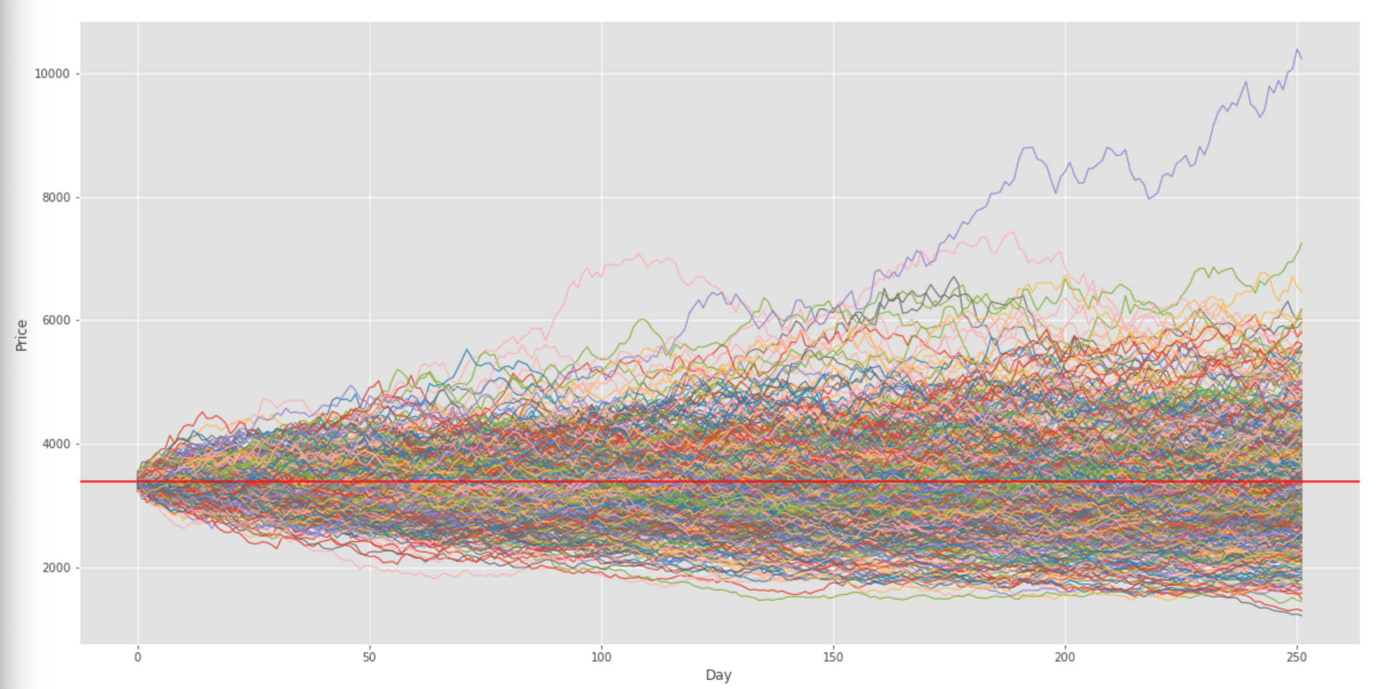
Stock Performance Review - AMZN
There is a 95% chance that if you invest $677,293.70 to purchase 200 shares in Amazon over the next year will end within a range of $358,037.86 and $1,118,510.85.
The simulation has the stock priced between $1,790 and $5,592 in the next year.

Slide 8
Portfolio Analysis
Invest in an equally weighted portfolio of undervalued stocks based on the DCF model simulation.
Amazon
Facebook
Alibaba
NetFlix

Slide 9
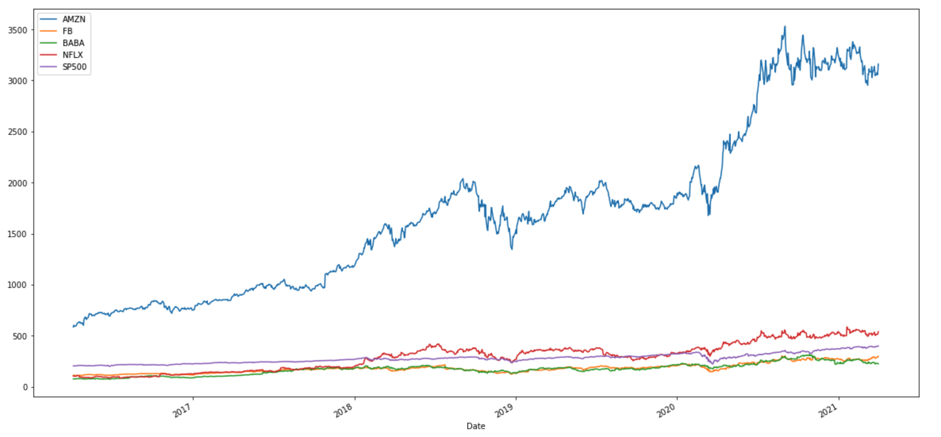
Historical Performance vs. S&P 500

Slide 10
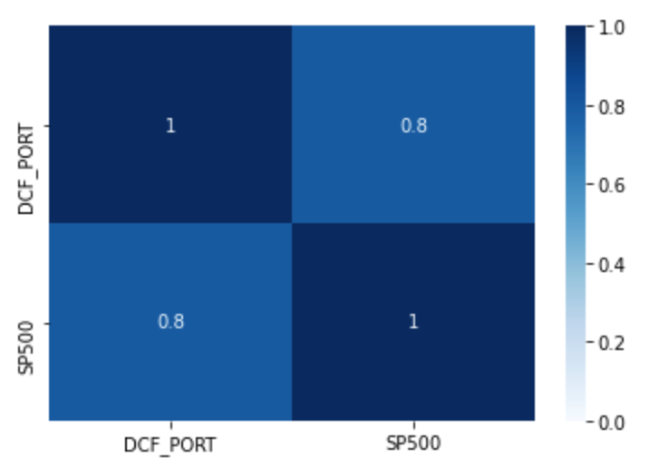
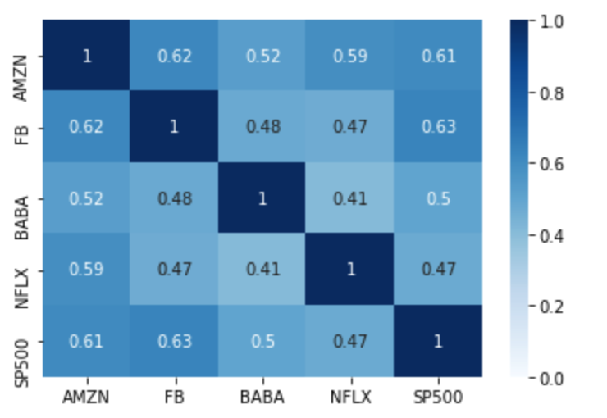
Correlation of Stocks and Portfolio with S&P 500

Slide 11
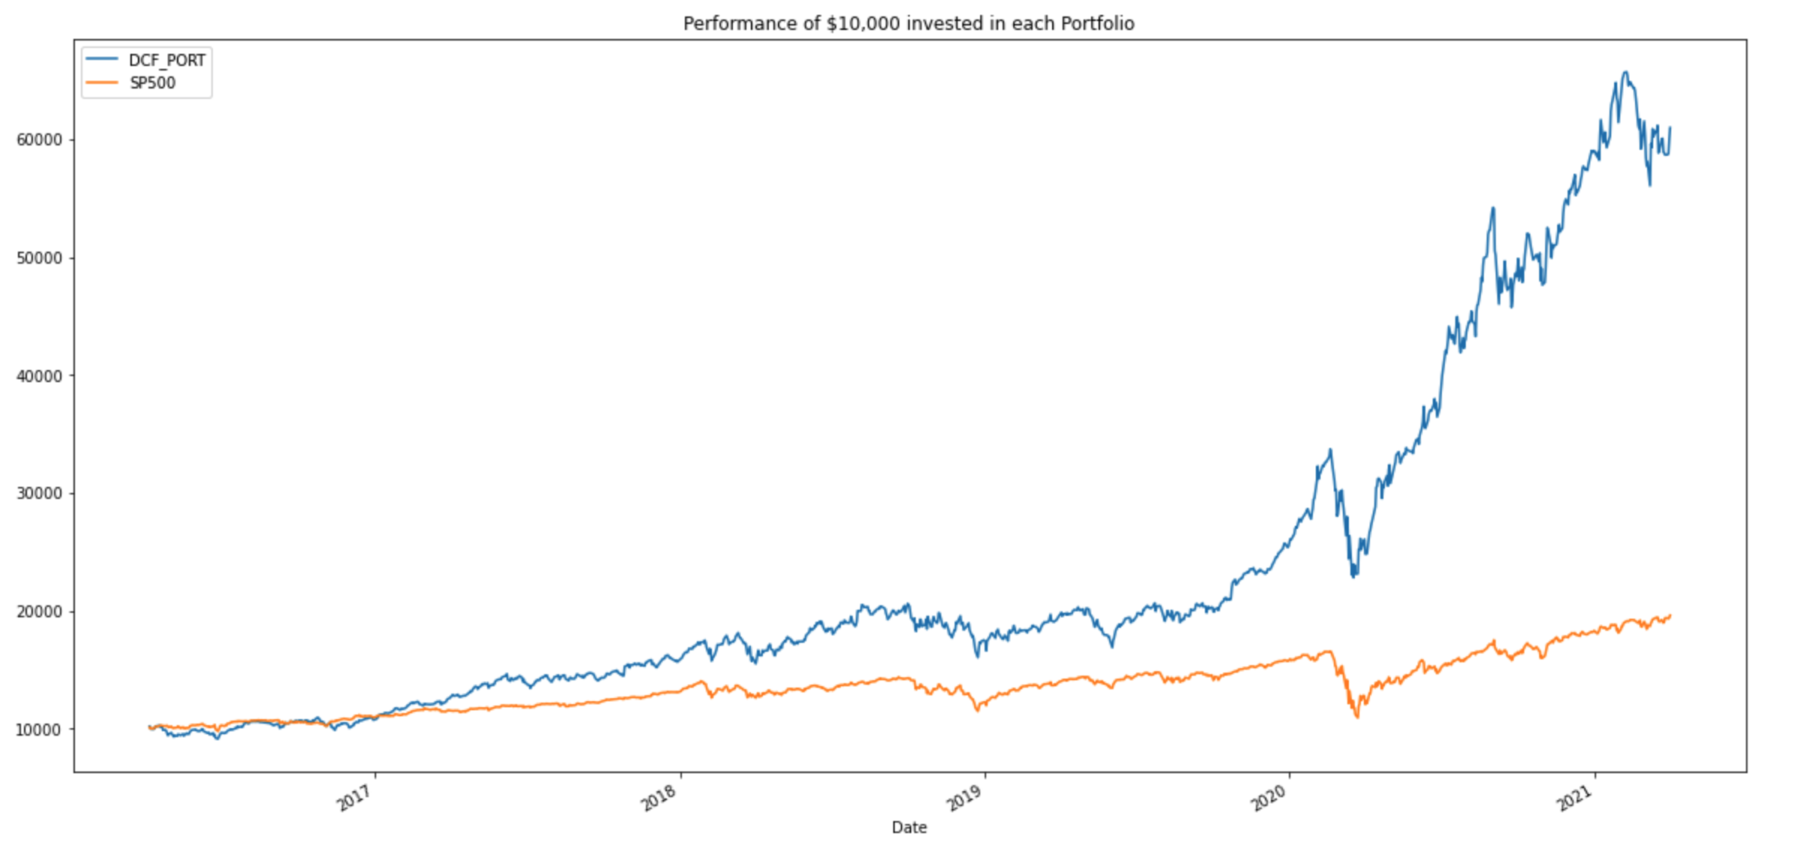
How does the portfolio perform?

Slide 12
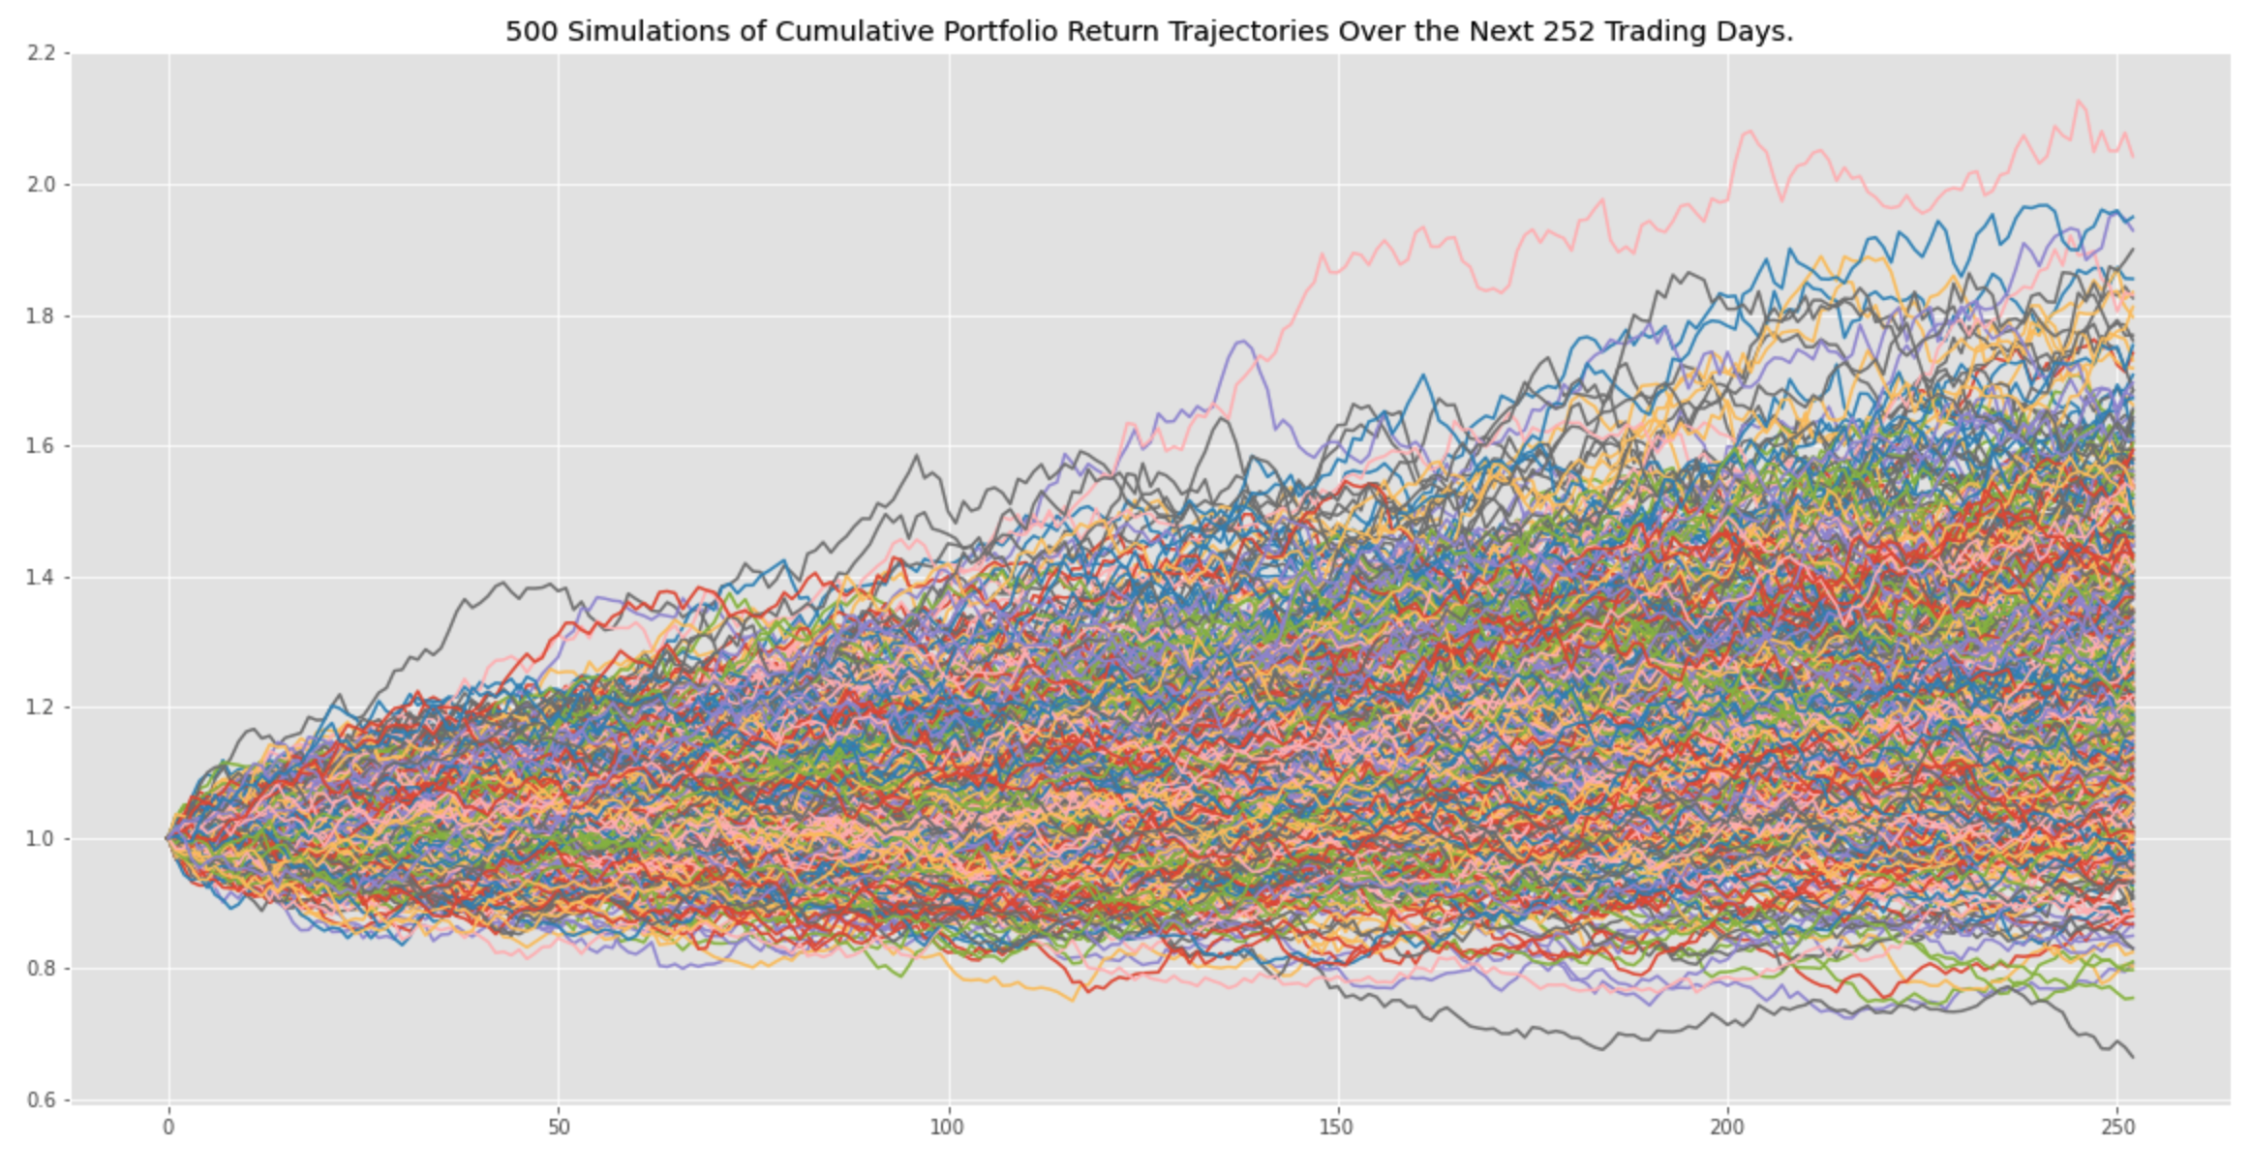
Monte Carlo Simulation
There is a 95% chance that an initial investment of $20,000 in the DCF Portfolio over the next year will end within a range of $17,492.95 and $34,951.53.

Slide 13

Conclusions
Current proof of concept had varying results based on the assumptions used and market timing.
Performance of stock and portfolio analysis based on investing in undervalued companies still proved to be a positive strategy measuring against the S&P 500.

Slide 14
Final Thoughts/Learnings
The model using a simple growth model created a heavy dependance on recent trend – which has been greatly affected by the pandemic.
Using this recent trend to forecast future growth should be refined to improve model performance and provide more sustainable growth modeling.
The model is heavily reliant on just financial data and forecasts are fundamentally informed guesses – we feel that we should being in some qualitative data to help smooth or explain exceptional growth or decline that shouldn’t be held constant as it is not sustainable.
Example would be Amazon’s growth due to the pandemic, conversely the model doesn’t work well for the Cruise sector given that there is a recent trend with no revenue that can’t be assumed to continue.

